Slide 1


Rashtrasant Tukdoji Maharaj Nagpur University ‘s OCE
CyberArk’s
Privileged Access Management (PAM)
Presented By
Guided By
Prachi C. Amgaonkar
Rishikesh Nikam
(Security Analyst at
Cyberi3Secure)
Post Graduation Diploma
Contact N0. 9156119974
In
Information Security
Post Graduation Diploma In Information Security
2023 - 2024
1

Slide 2

About CyberArk
CyberArk is the global leader in Identity Security. Centered on privileged access management, CyberArk provides the most comprehensive security offering for any identity – human or machine – across business applications, distributed workforces, hybrid cloud workloads and throughout the DevOps lifecycle. The world’s leading organizations trust CyberArk to help secure their most critical assets.
For over a decade CyberArk has led the market in securing enterprises against cyber attacks that take cover behind insider privileges and attack critical enterprise assets. Today, only CyberArk is delivering a new category of targeted security solutions that help leaders stop reacting to cyber threats and get ahead of them, preventing attack escalation before irreparable business harm is done.
As a component of information security, it is utilized by around half of Fortune 500 organizations worldwide.
Privileged Access Management (PAM )
2023 - 2024
2

Slide 3
ontent
Content
Abstract
Introduction
Objectives
Methodology
Tools
Testing /experimentation
Data collection /Data analysis
Finding and results
Conclusion
Future Scope
Reference
Privileged Access Management (PAM )
2023 - 2024
3

Slide 4
.
1. Abstract
CyberArk Privileged Access Management (PAM) is a comprehensive solution designed to secure and manage privileged accounts and credentials within an organization. PAM refers to the set of practices and technologies used to control, monitor, and protect privileged access to critical systems and data.
At its core, CyberArk PAM focuses on securing privileged accounts, which are accounts with elevated privileges that provide users with administrative access to sensitive resources, such as servers, databases, network devices, and applications. These privileged accounts pose a significant security risk if not properly managed, as they can be exploited by cyber attackers to gain unauthorized access and carry out malicious activities.
Privileged Access Management (PAM )
2023 - 2024
4

Slide 5
2. Introduction
Organizations implement privileged access management (PAM) to protect against the threats posed by credential theft and privilege misuse.
PAM refers to a comprehensive cybersecurity strategy – comprising people, processes and technology – to control, monitor, secure and audit all human and non-human privileged identities and activities across an enterprise IT environment.
Sometimes referred to as Privileged Identity Management (PIM) or Privileged Access Security (PAS) , PAM is grounded in the Principle of least privileged , wherein users only receive the minimum levels of access required to perform their job functions.
The principle of least privilege is widely considered to be a cybersecurity best practice and is a fundamental step in protecting privileged access to high-value data and assets.
Privileged Access Management (PAM )
2023 - 2024
5

Slide 6
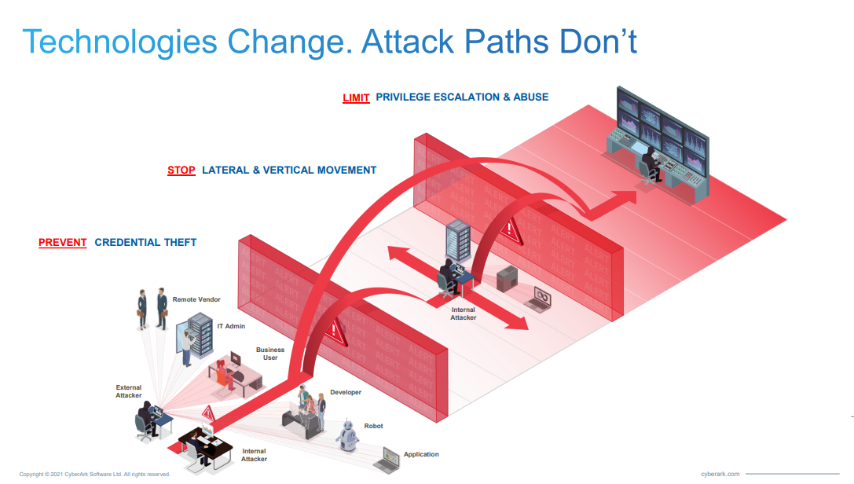
2. Introduction
Privileged Access Management (PAM )
2023 - 2024
6

Slide 7
3. Objectives
Privileged Account Discovery - user accounts, service accounts, application accounts.
Privileged Account Protection - Once the privileged accounts are discovered, CyberArk PAM aims to protect and secure them by enforcing strong password policies.
Privileged Session Management - CyberArk PAM provides session isolation and monitoring capabilities.
Credential Vaulting and Management - CyberArk PAM offers a secure and centralized vault for storing privileged account credentials
Privileged Access Governance - This objective involves implementing policies and controls to manage and govern privileged access effectively
Privileged Access Management (PAM )
2023 - 2024
7

Slide 8
3. Objectives
Threat Analytics and Detection - CyberArk PAM includes advanced analytics and machine learning capabilities to detect anomalous behavior, identify potential threats.
Compliance and Auditing - comprehensive auditing and reporting capabilities, including session recording, access logs, and activity logs.
Integration and Automation - CyberArk PAM can integrate with other security solutions and IT infrastructure components, such as identity and access management (IAM) systems, SIEM platforms
Privileged Access Management (PAM )
2023 - 2024
8

Slide 9

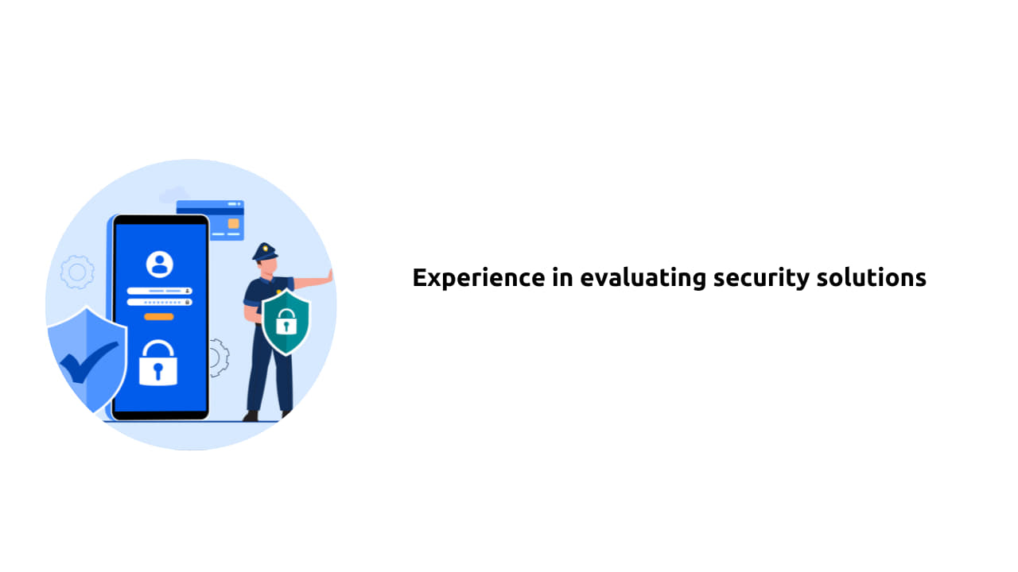
4. Methodology
Discovery and Assessment
Planning and Design
Deployment
Privileged Account Discovery and Onboarding
Access Management and Monitoring
Ongoing Management and Maintenance
Training and Education
Privileged Access Management (PAM )
2023 - 2024
9

Slide 10
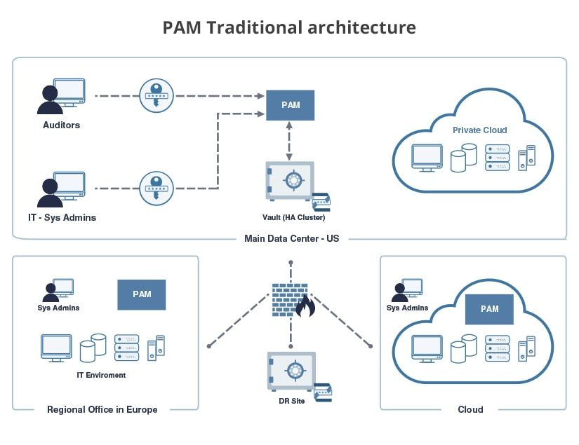
CyberArk Privileged Access Solution Architecture
Privileged Access Management (PAM )
2023 - 2024
10

Slide 11
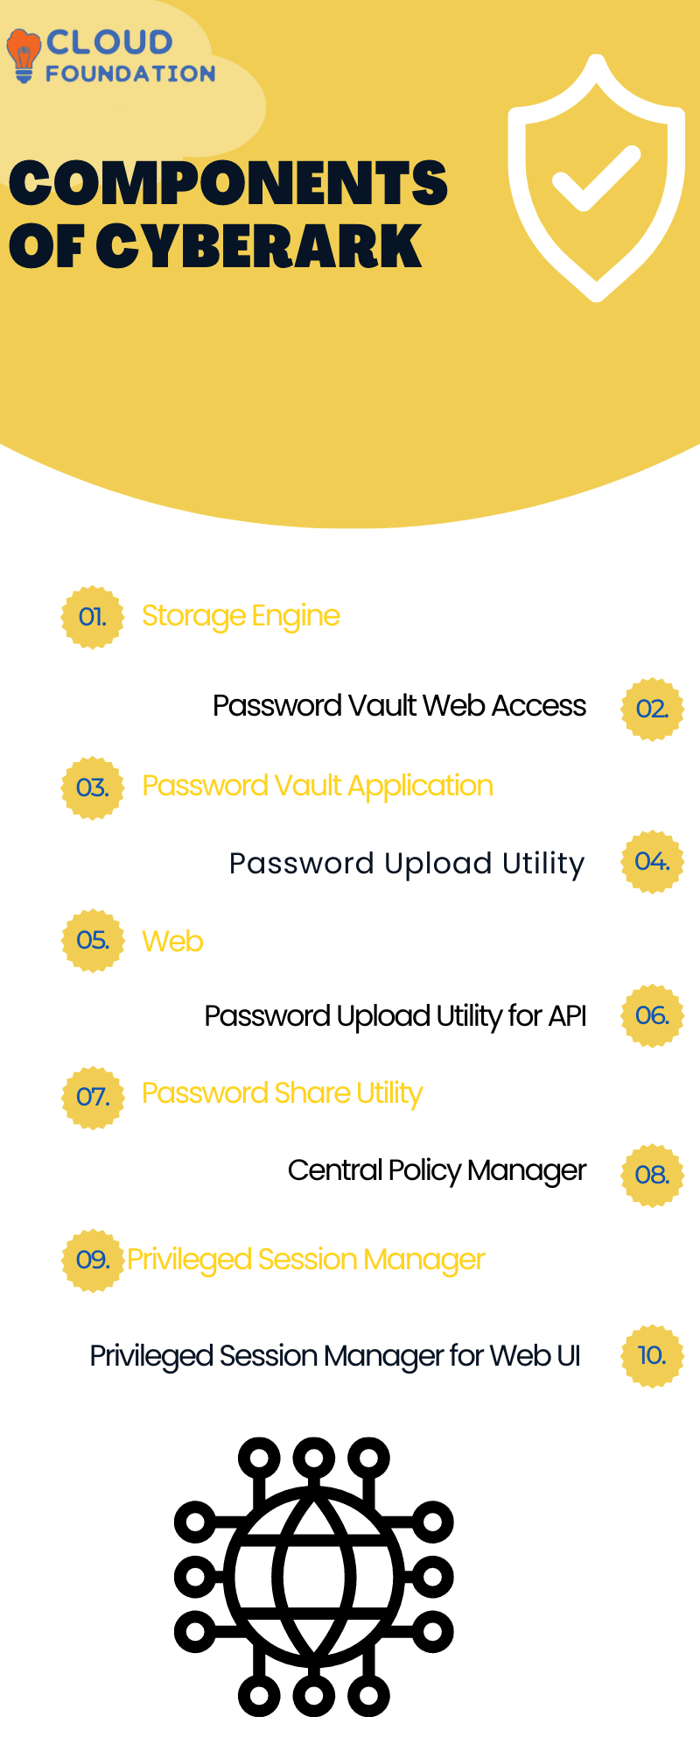

Components of CyberArk
Privileged Access Management (PAM )
2023 - 2024
11

Slide 12
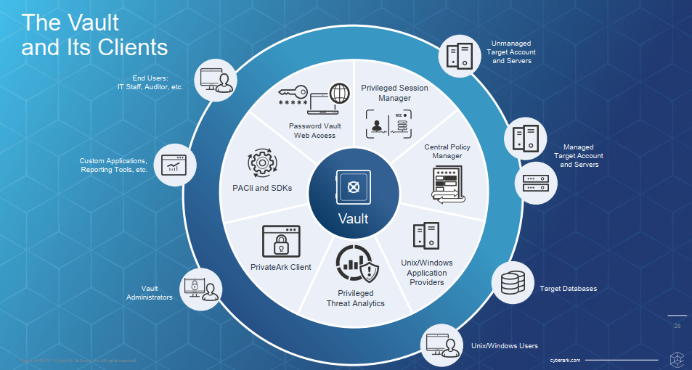
Working of Vault
Privileged Access Management (PAM )
2023 - 2024
12

Slide 13
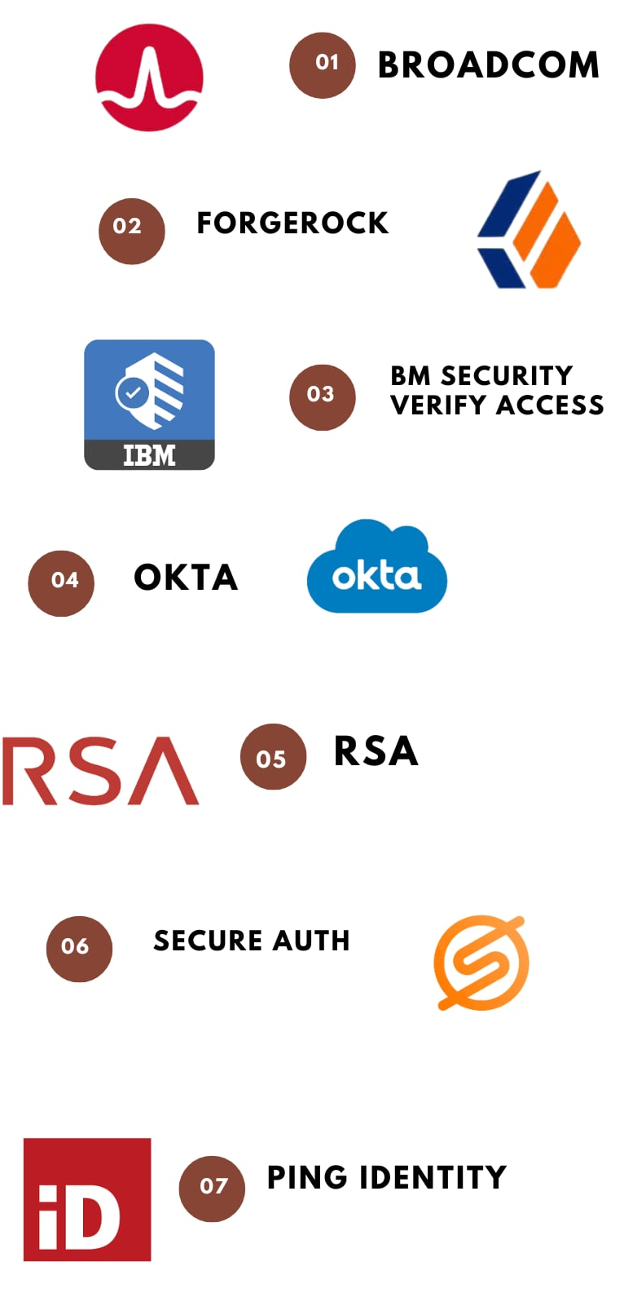
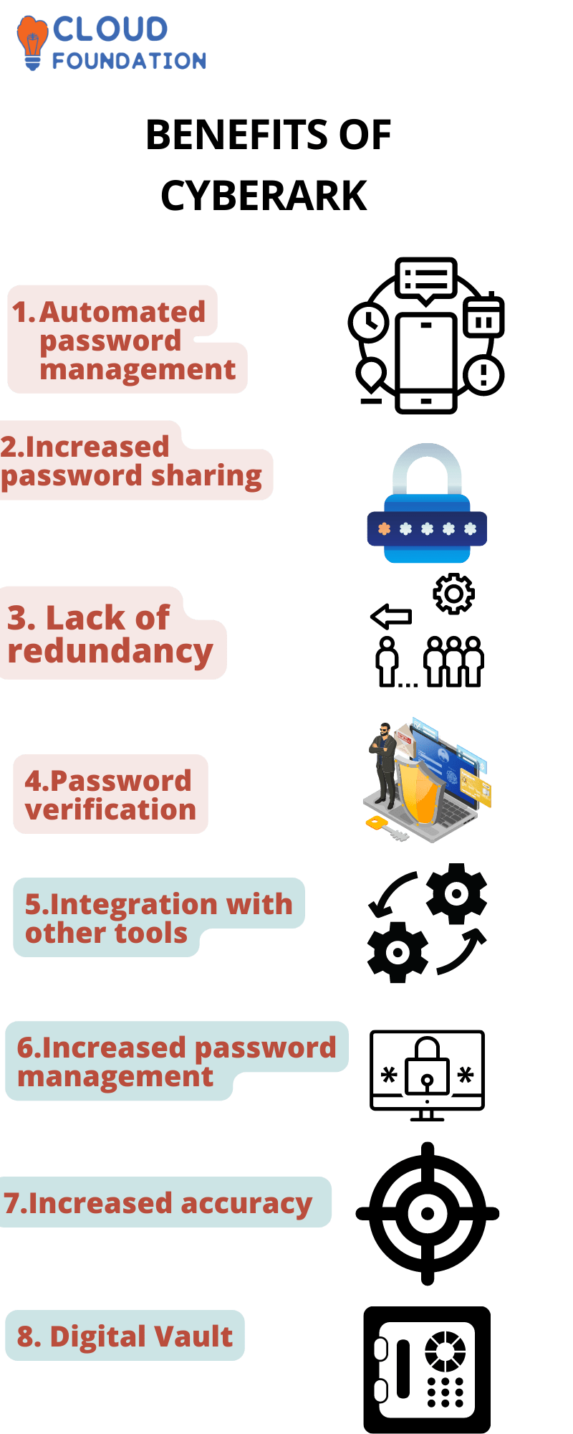
Benefits of CyberArk
Privileged Access Management (PAM )
2023 - 2024
13

Slide 14
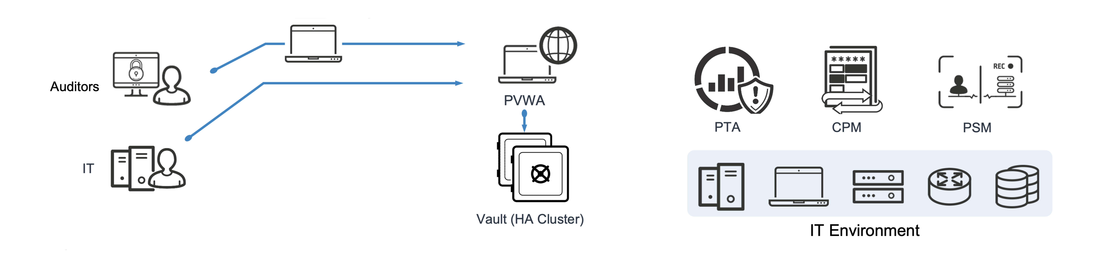
Privileged Access Manager - Self-Hosted Architecture
Privileged Access Management (PAM )
2023 - 2024
14

Slide 15
PAM - Self-Hosted provides a ‘Safe Haven’ within your enterprise where all your administrative passwords can be securely archived, transferred and shared by authorized users, such as IT staff, on-call administrators, and local administrators in remote locations.
Vault - The CyberArk Digital Vault is the most secure place in the network where sensitive data can be stored. The Vault is designed to be installed on a dedicated computer, for complete data isolation.
Password Vault Web Access (PVWA) - PVWA is a fully featured web interface that provides a single console for requesting, accessing and managing privileged passwords throughout the enterprise by both end users and administrators with almost no training.
PrivateArk Client - The PrivateArk Client is a regular Windows application that is used as the administrative client for the PAM - Self-Hosted solution. It can be installed on any number of remote computers, and can access the Vault by any combination of LAN, WAN or the Internet.
The Central Policy Manager - The PAM - Self-Hosted solution provides a revolutionary breakthrough in password management with the CyberArk Central Policy Manager (CPM), which automatically enforces enterprise policy.
Privileged Session Manager (PSM) - PSM enables organizations to secure, control and monitor privileged access to network devices.
Privileged Access Management (PAM )
2023 - 2024
15

Slide 16
Data Collection and analysis
Privileged account Inventory - Provides information about all the privileged accounts in the system, based on different filters.
Applications Inventory- Provides information about all the privileged accounts in the system, based on different filters.
Privileged Accounts Compliance Status - An inventory that indicates which accounts are compliant with their platforms, how accounts are managed in order to make them compliant, when password changes are planned, and their management status.
Entitlement Report- Users’ entitlement rights in PAM - Self-Hosted regarding user, Safe, active platform, target machine, target account, etc.
Activity log - A log of all the activities that have taken place in the Safes. This report can be filtered according to user, target system, specified period, and a variety of other criteria.
Privileged Access Management (PAM )
2023 - 2024
16

Slide 17
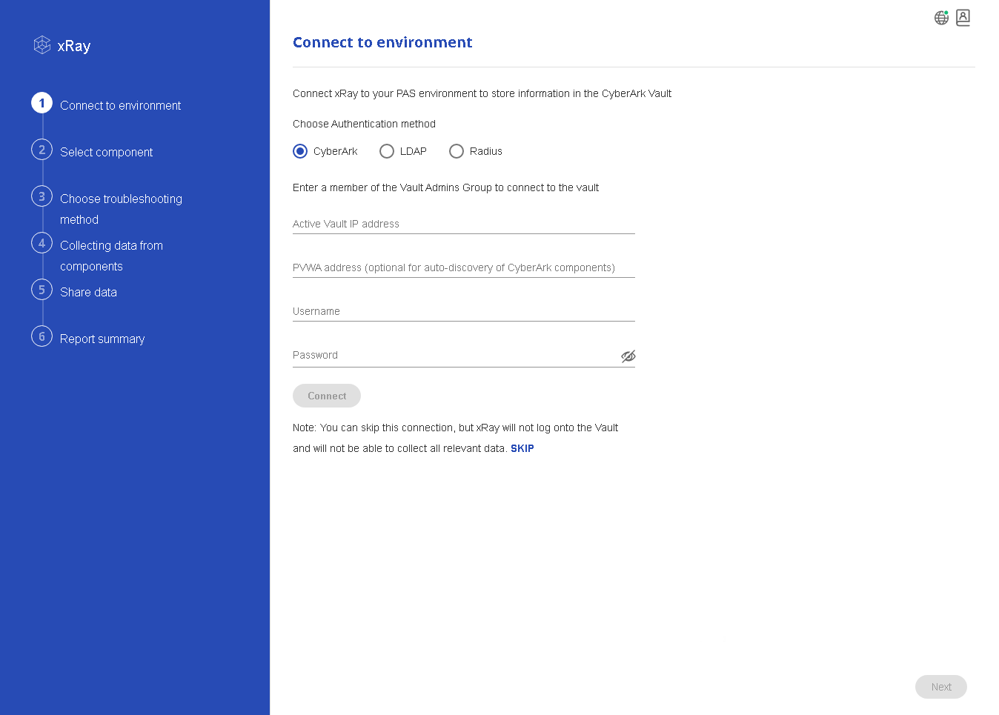
Collecting data and logs
Step 1 . Connect to the envoirnment
Privileged Access Management (PAM )
2023 - 2024
17

Slide 18
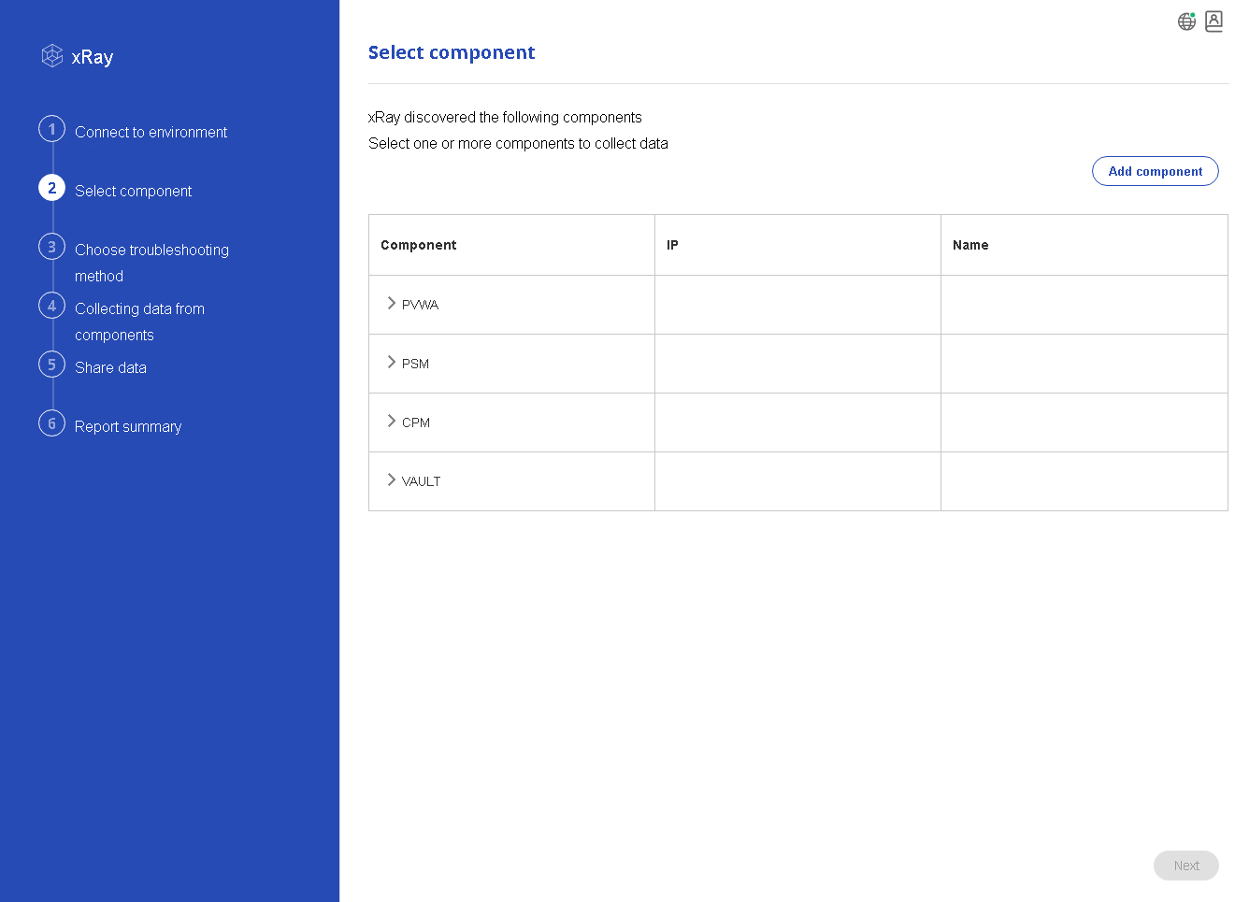
Collecting data and logs
Step 2 . Select the components
Privileged Access Management (PAM )
2023 - 2024
18

Slide 19
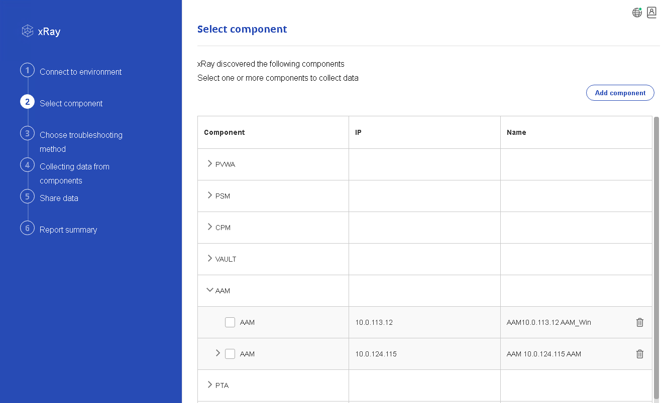
Collecting data and logs
Select all the components that you want to collect logs for, and then click Next.
Privileged Access Management (PAM )
2023 - 2024
19

Slide 20
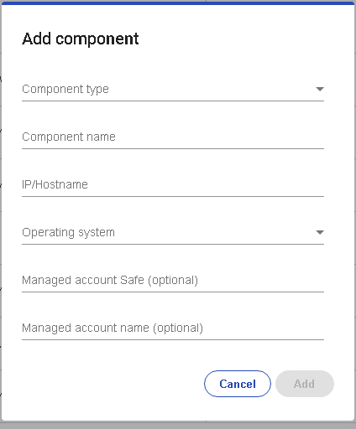
Collecting data and logs
Add components manually
1.Click Add component.
Privileged Access Management (PAM )
2023 - 2024
20

Slide 21
Collecting data and logs
2. Specify the following details for each component that you want to scan.
Parameter | Description | Default value | Mandatory
[Component Name] | The display name for the component/server. | Clear text | Yes
Type | CyberArk component, listed by Operating System. | For Windows: VAULT/PVWA/PSM/CPM/AAM For Linux: PTA/PSMP/AAM/OPM/PSMW | Yes
IP | The component IP. | None | Yes
VaultIP | IP of the Production Vault that the component server is working with. |  | No
OSType | The server's OS type. | Windows/Linux | Yes
AccountSafe | The Safe where the privileged account that contains the local Admin credentials is stored. | Safe Name | No
AccountName | Name of the privileged account that contains the local Admin credentials. | Account name | No
Privileged Access Management (PAM )
2023 - 2024
21

Slide 22
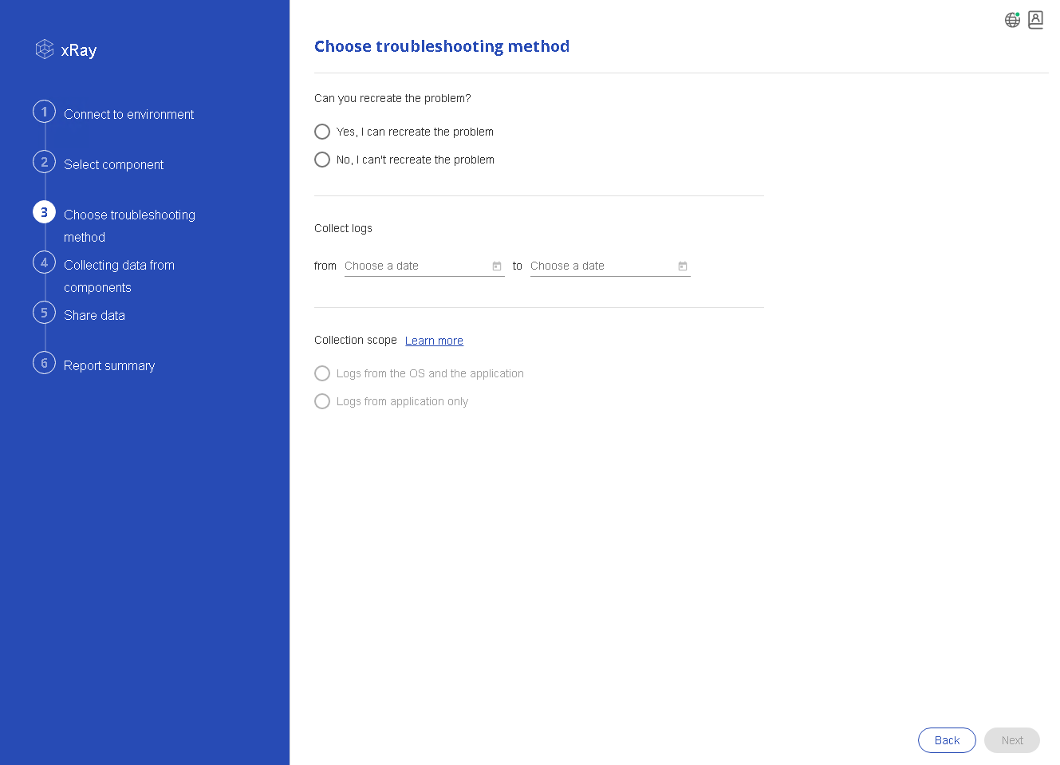
Collecting data and logs
Step 3 . Choose the troubleshooting method
You can recreate the problem,
Select Yes, I can recreate the problem.
In the Collect Logs area, select the time frame that you want to collect information for. The default is the current day.
In the Collection scope area, select the scope:
Logs from the OS and the application - Collects general information from the machine
Logs from application only - Collects the component logs
Click Next.
You are prompted to begin recording the problem.
Privileged Access Management (PAM )
2023 - 2024
22

Slide 23
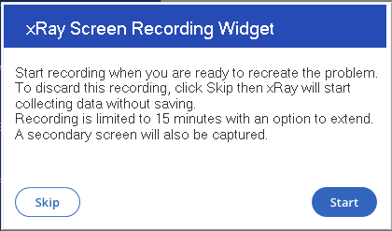
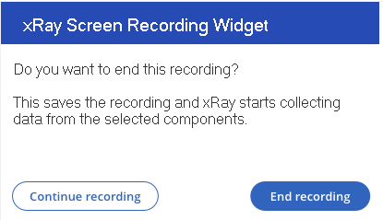
Collecting data and logs
You are prompted to begin recording the problem.
After the issue is reproduced, click Stop.
Click End recording.
Privileged Access Management (PAM )
2023 - 2024
23

Slide 24
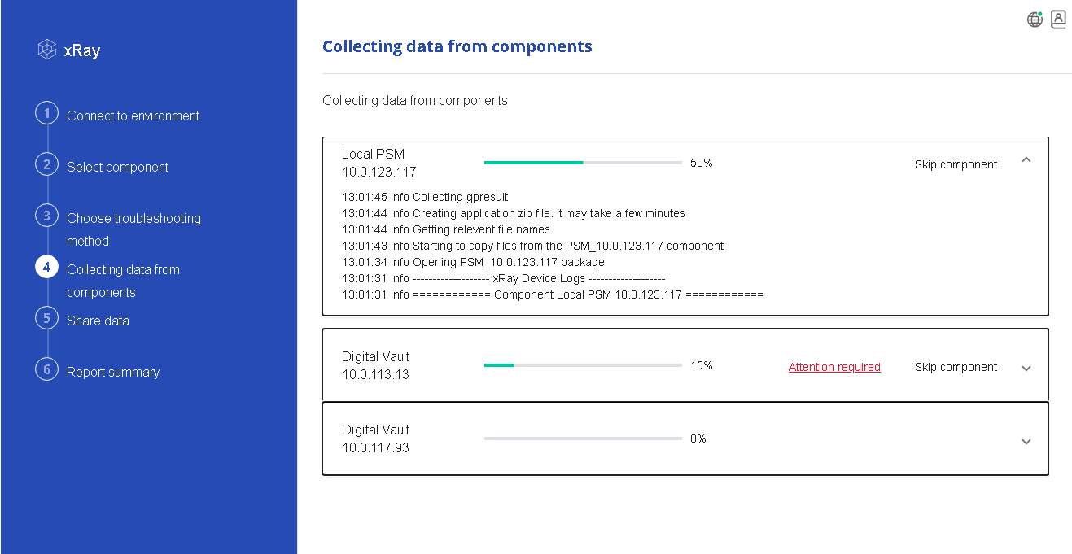
Collecting data and logs
Step 4 . Collecting data from components:
Privileged Access Management (PAM )
2023 - 2024
24

Slide 25
Finding and Results
CyberArk's PAM solutions are designed to protect against insider threats, external attacks, and other unauthorized access by managing and securing privileged credentials, monitoring privileged user activities, and controlling access to sensitive systems and information.
The primary goal of CyberArk's PAM solutions is to reduce the risk of security breaches by controlling and monitoring access to privileged accounts and assets.
PAM refers to the practice of managing and securing privileged accounts and access within an organization's IT environment. Privileged accounts are those that have elevated permissions and access to critical systems, applications, and data.
Privileged Access Management (PAM )
2023 - 2024
25

Slide 26
Conclusion
In a time when cyber threats are constantly evolving and the consequences of data breaches are severe, CyberArk's PAM solutions stand as a key defense mechanism. Their robust features, continuous innovation, and commitment to cybersecurity excellence make them a trusted partner for organizations aiming to safeguard their most sensitive assets and maintain a strong security posture in the face of ever-evolving cyber risks.
As organizations continue to adopt cloud technologies, mobile devices, and interconnected systems, CyberArk's PAM solutions evolve to address the challenges of securing privileged access in these complex environments. The integration capabilities with other security tools and platforms further enhance the holistic security approach.
Privileged Access Management (PAM )
2023 - 2024
26

Slide 27
Reference
1. Cyberark PAM: Cyberark Privileged Access Management - HKR (hkrtrainings.com)
2. CyberArk Reviews, Ratings & Features 2023 | Gartner Peer Insights
3. August 2023 - Cybersecurity Memo (51sec.org)
4. The Gartner 2020 Magic Quadrant for PAM is Here! (cyberark.com)
5. CyberArk Docs
Privileged Access Management (PAM )
2023 - 2024
27

Slide 28
THANK YOU
Privileged Access Management (PAM )
2023 - 2024
28

